Slide 1
Complex Project Scheduling Lessons Learned from NASA, Boeing, General Dynamics and Others
IEEE Aerospace Conference 2019
Rob Richards, Ph.D.
Stottler Henke Associates, Inc.

Slide 2
LESSONS
Efficient scheduling is incredibly difficult
  Significant productivity lost due to inferior scheduling
Learn from the human schedulers
Model to level of detail required
Reveal & explain the schedule
Easy & fast to perform scenarios / what-ifs

Slide 3
Efficient Scheduling Difficult
  Model to level of detail required
  Capture human reasoning
  Different scheduling applications generally require different algorithms

Slide 4
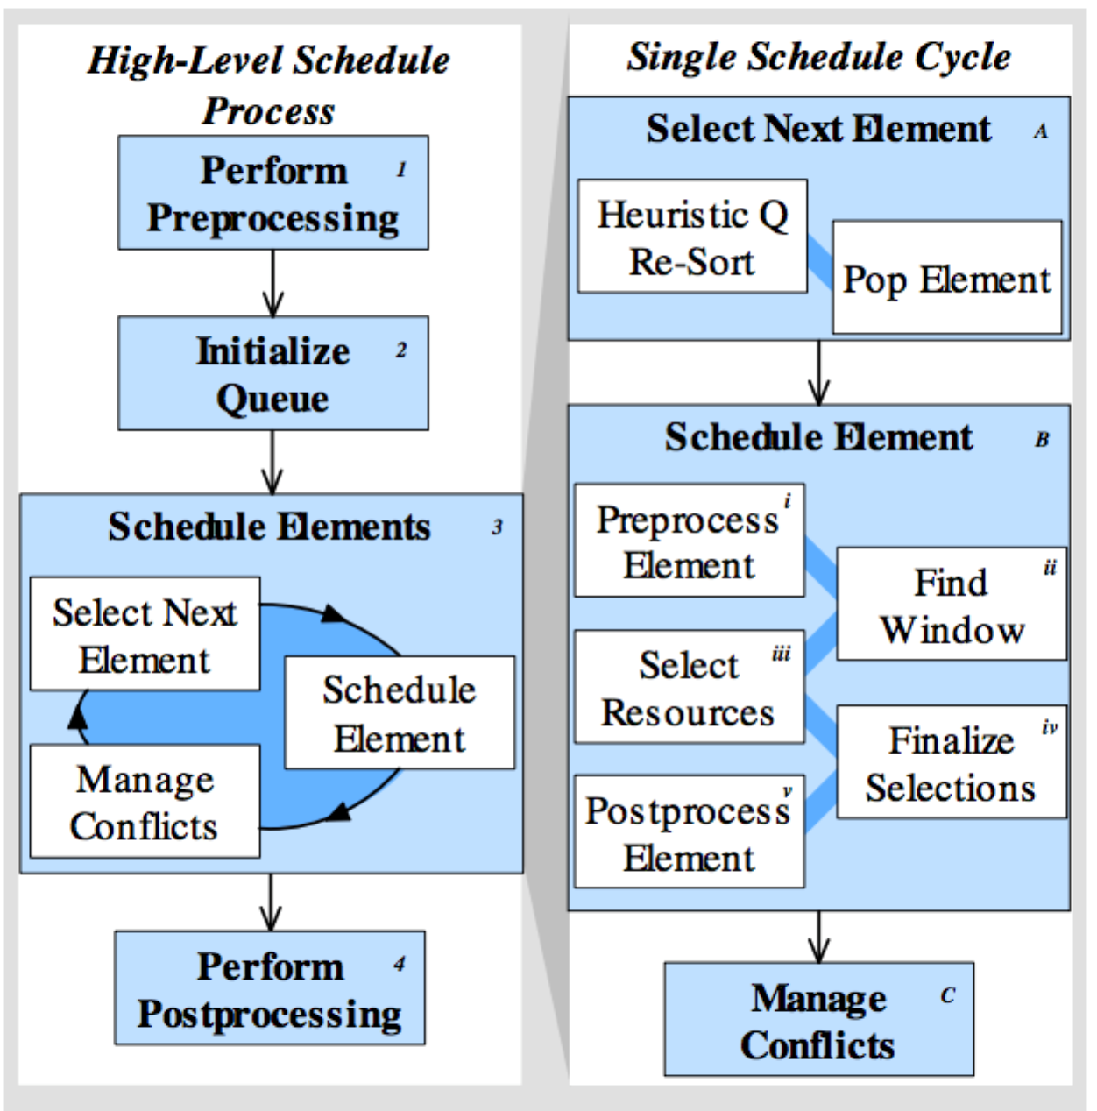
Aurora’s scheduling process breakdown

Slide 5
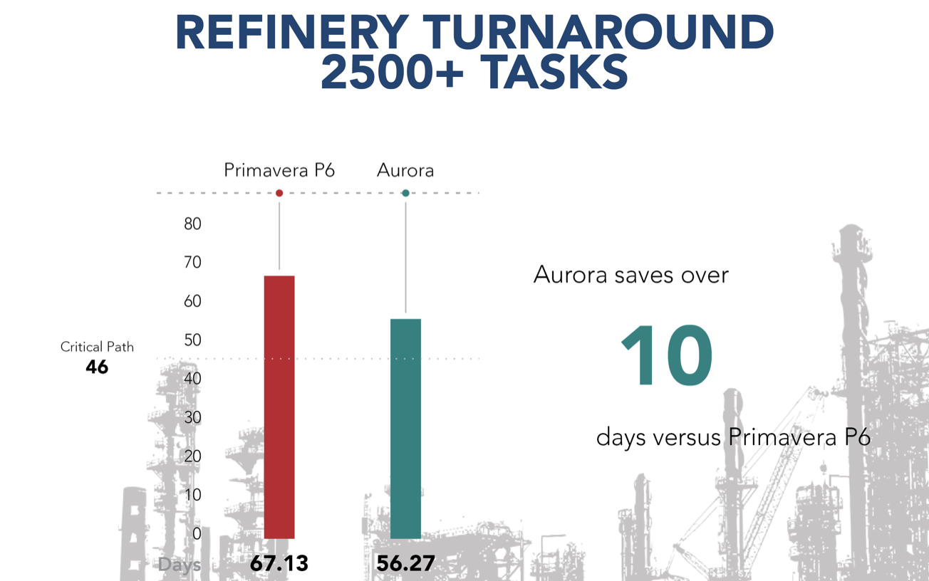
Scheduling results – refinery project

Slide 6
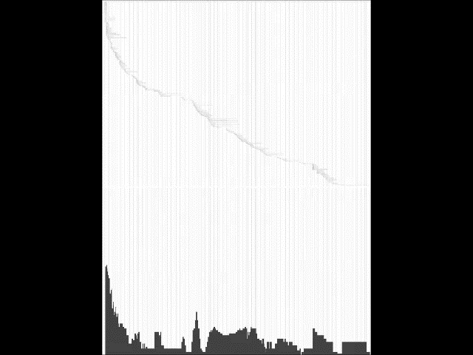
MS Project results VS. Aurora-ksc results

Slide 7
Learn from HUMAN SCHEDULERS
  When decisions / tradeoffs need to be made, use the expertise of expert schedulers
    So that the scheduling system reacts as a human expert wants it to
    E.g., when to work overtime, when to outsource
  Different scheduling applications generally require different algorithms
    Human experts help drive the best decision per algorithms

Slide 8
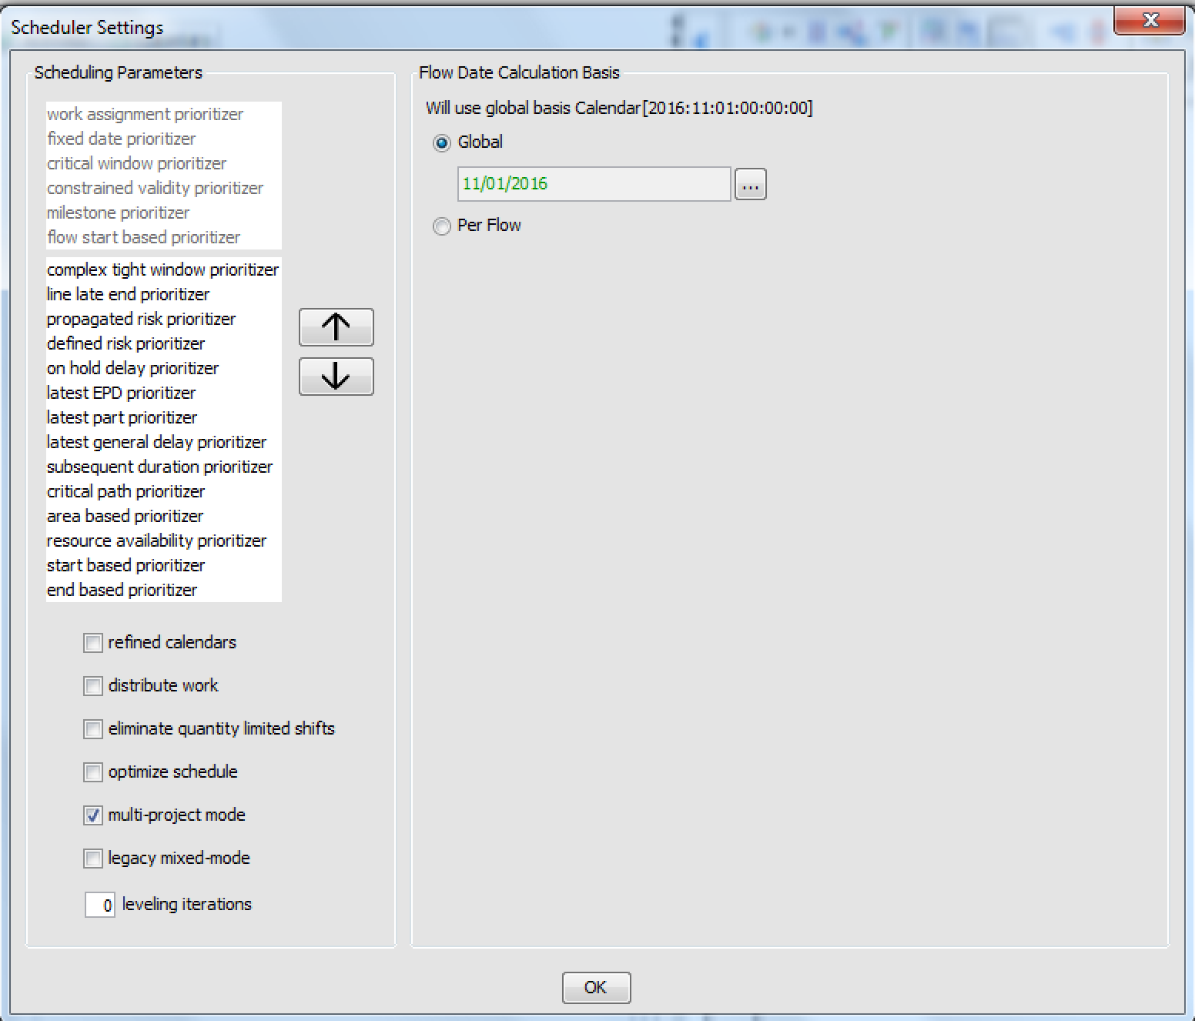
USER SETTINGS

Slide 9
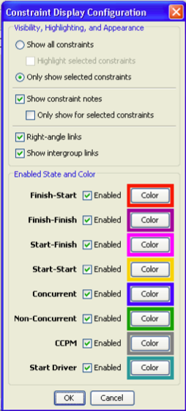
MODEL TO level of detail required
Technical constraints (E.g., F-S, F-F, S-F, lags)
Resources
  Labor: Occupation, skills, certifications
  Equipment, Tools (e.g., cranes)
Usage constraints – e.g., tool can only be used for so many hours continuously &/or during a day.
Spatial / physical space – e.g.,
  job requires a certain location or type of space
  two elements should (or should not) be next to each other
Equipment substitutions – equipment down, know & use substitutes

Slide 10
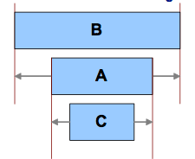
Concurrent CONSTRAINTS

Slide 11
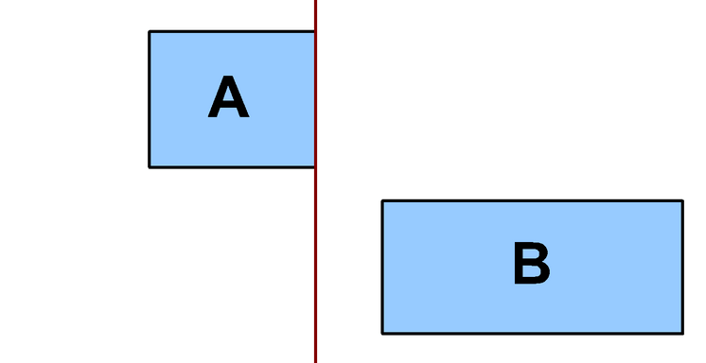
Non-concurrent CONSTRAINT

Slide 12
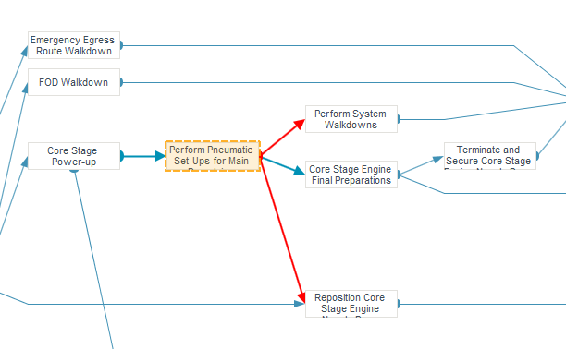
NON-CONCURRENT constraints: red arrows

Slide 13
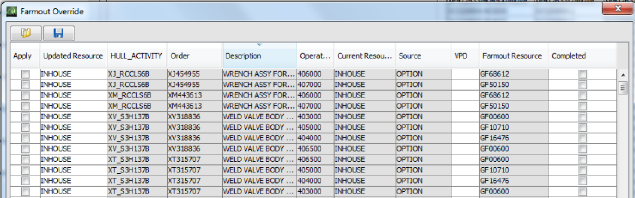
Outsource AUTOMATION

Slide 14
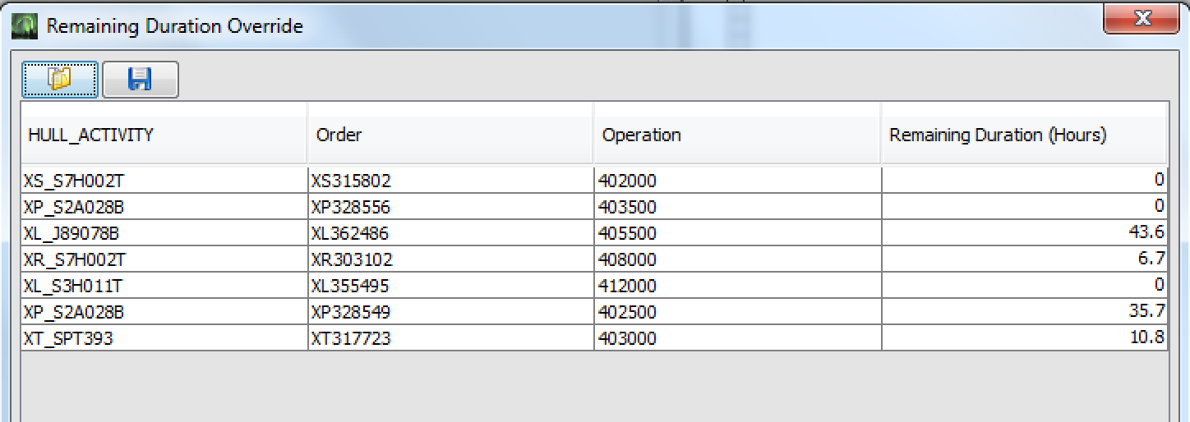
Remaining duration override

Slide 15
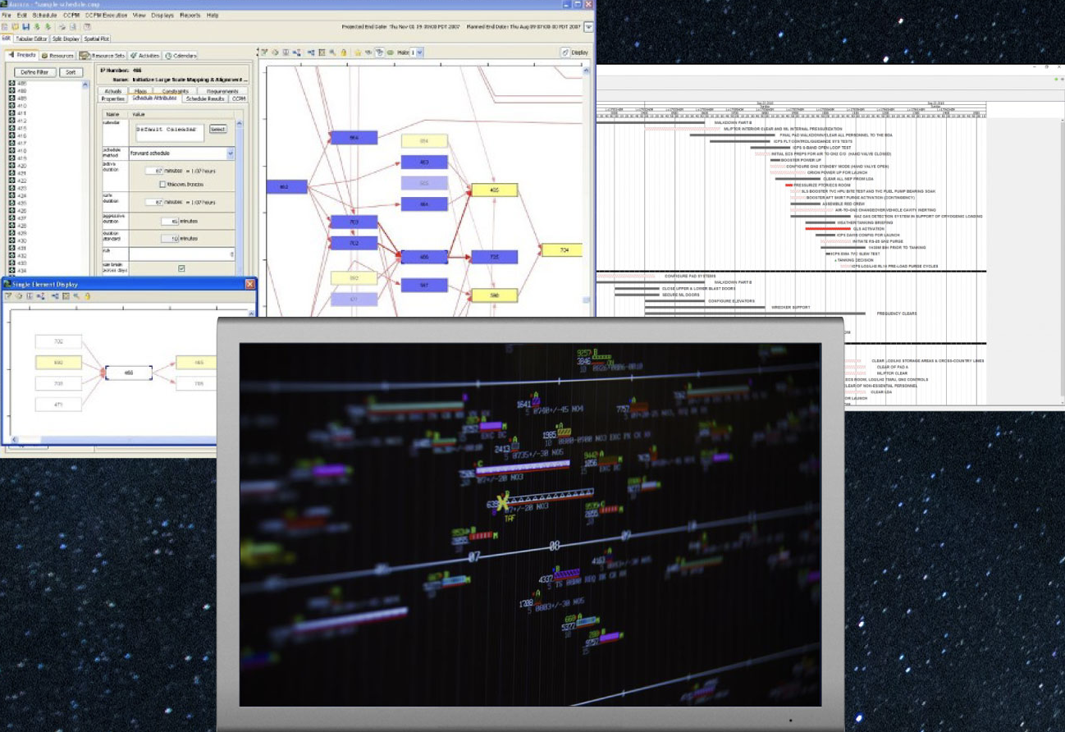
Reveal and explain the schedule

Slide 16
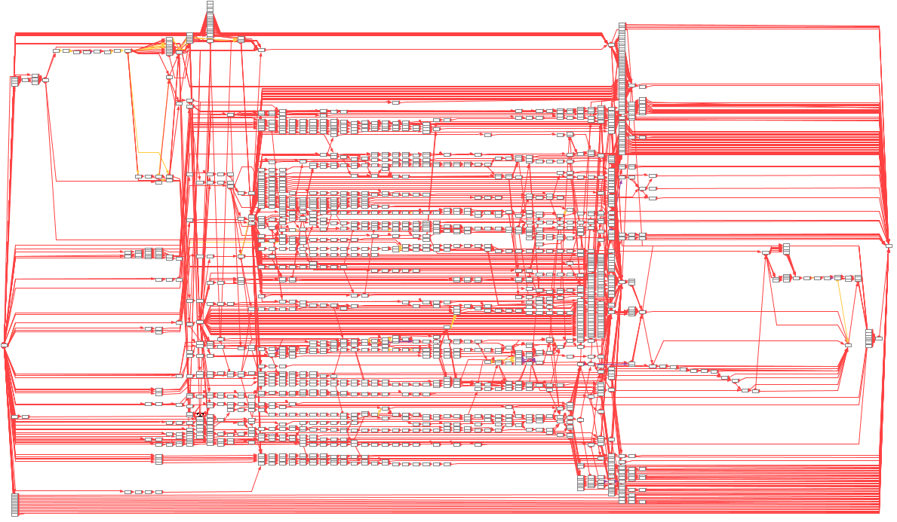
project network

Slide 17
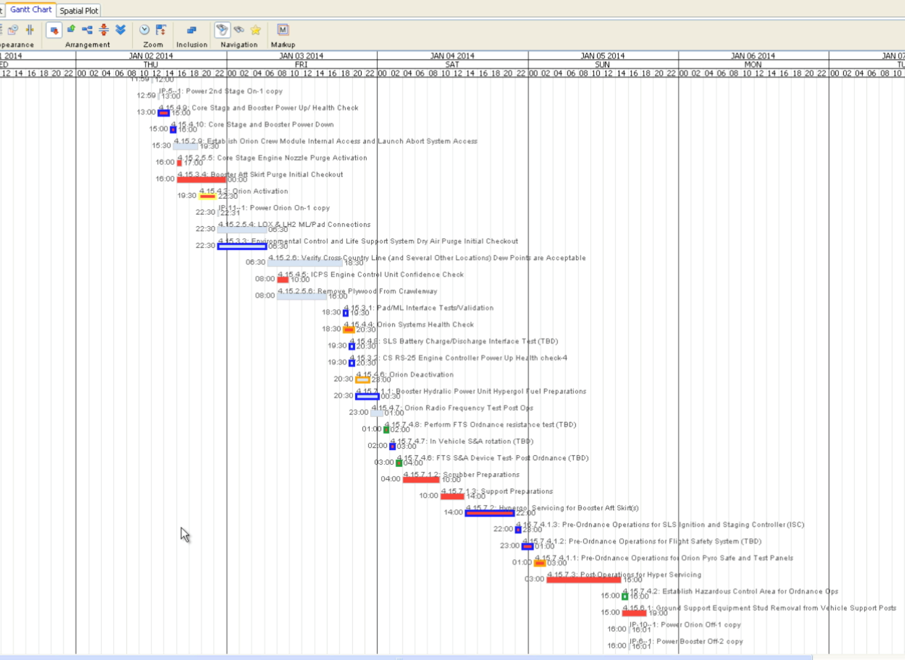
Gantt chart color-coded
PER USER desired criteria

Slide 18
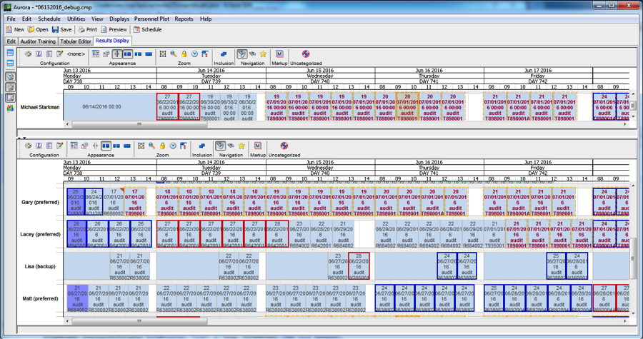
Team assignment display

Slide 19
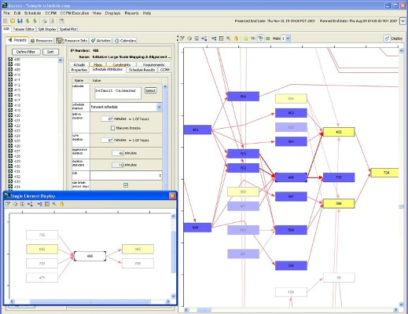
Network diagram showing single-element view option

Slide 20
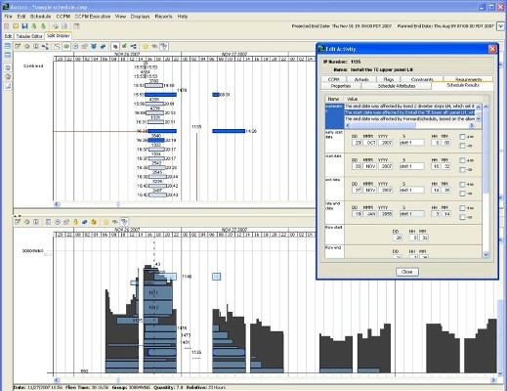
Split view showing Gantt chart same time slice as histogram, showing activities constituting resource need for one time instance

Slide 21
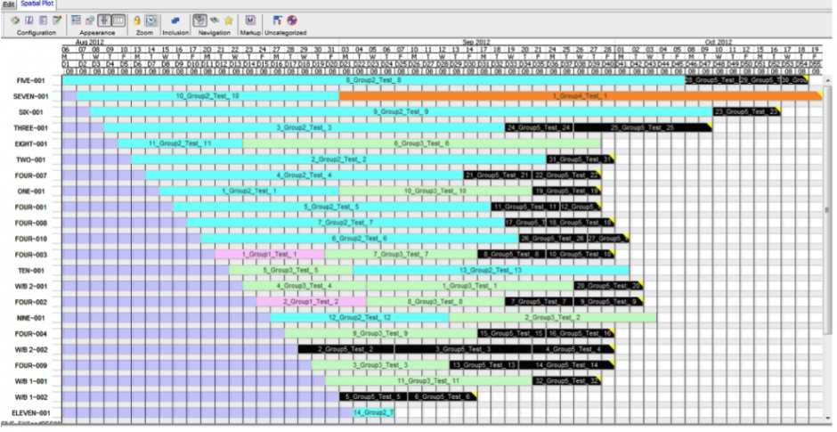
Vehicle testing schedule with build pitch

Slide 22
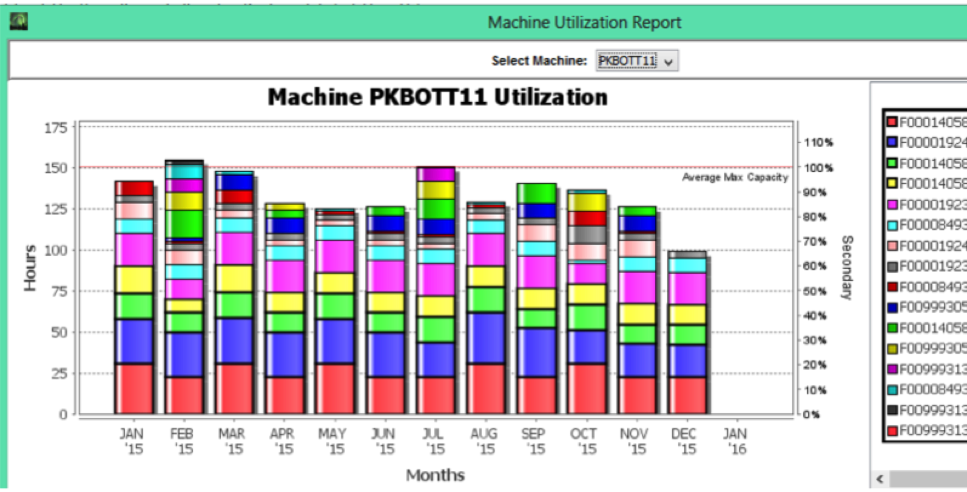
Pharma Manufacturing
Machine Utilization Report
Shows overall utilization of products by line
Allows planners to see overall allocation and line balancing

Slide 23
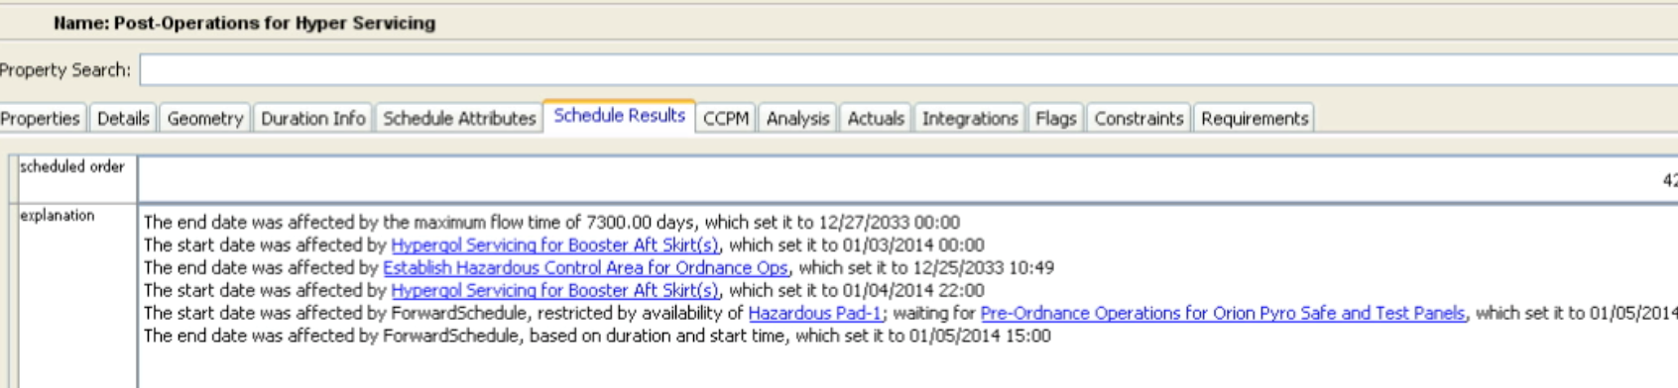
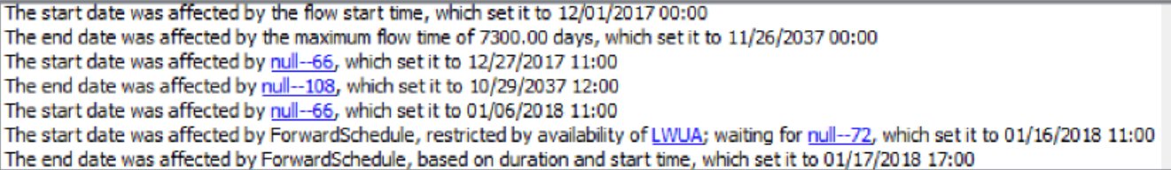
Automatically generated explanation

Slide 24
Easy & fast to perform scenarios / what-ifs
Wall clock minimization to run a scenario critical so schedulers will actually run them
Provide ways to graphically compare results

Slide 25
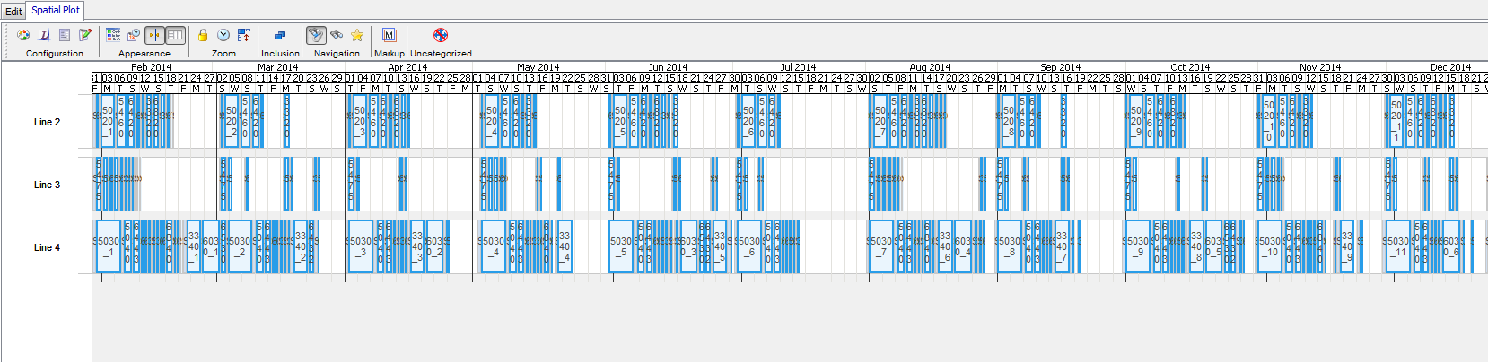
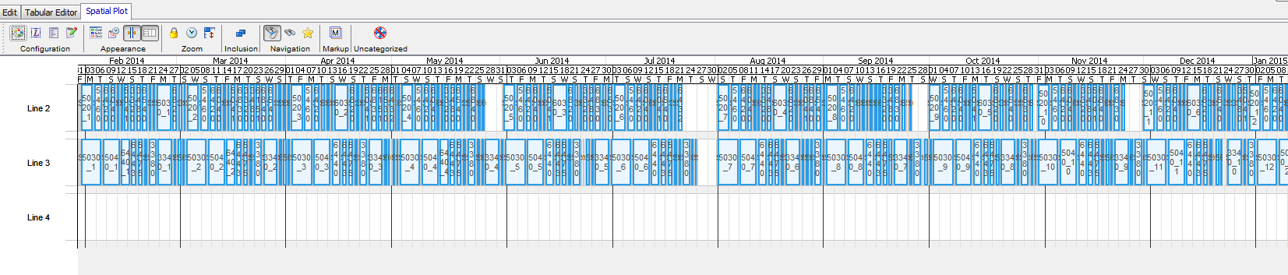
What-If: Same Demand 3 vs 2 Lines

Slide 26
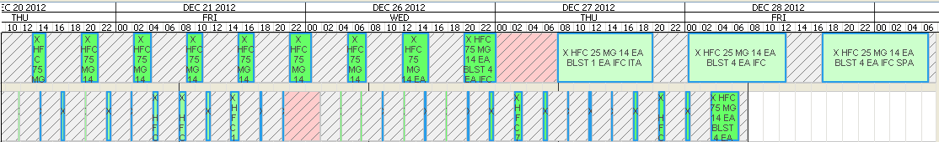
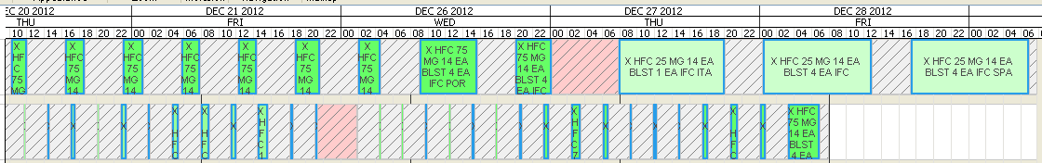
What-if: Demand Increase

Slide 27
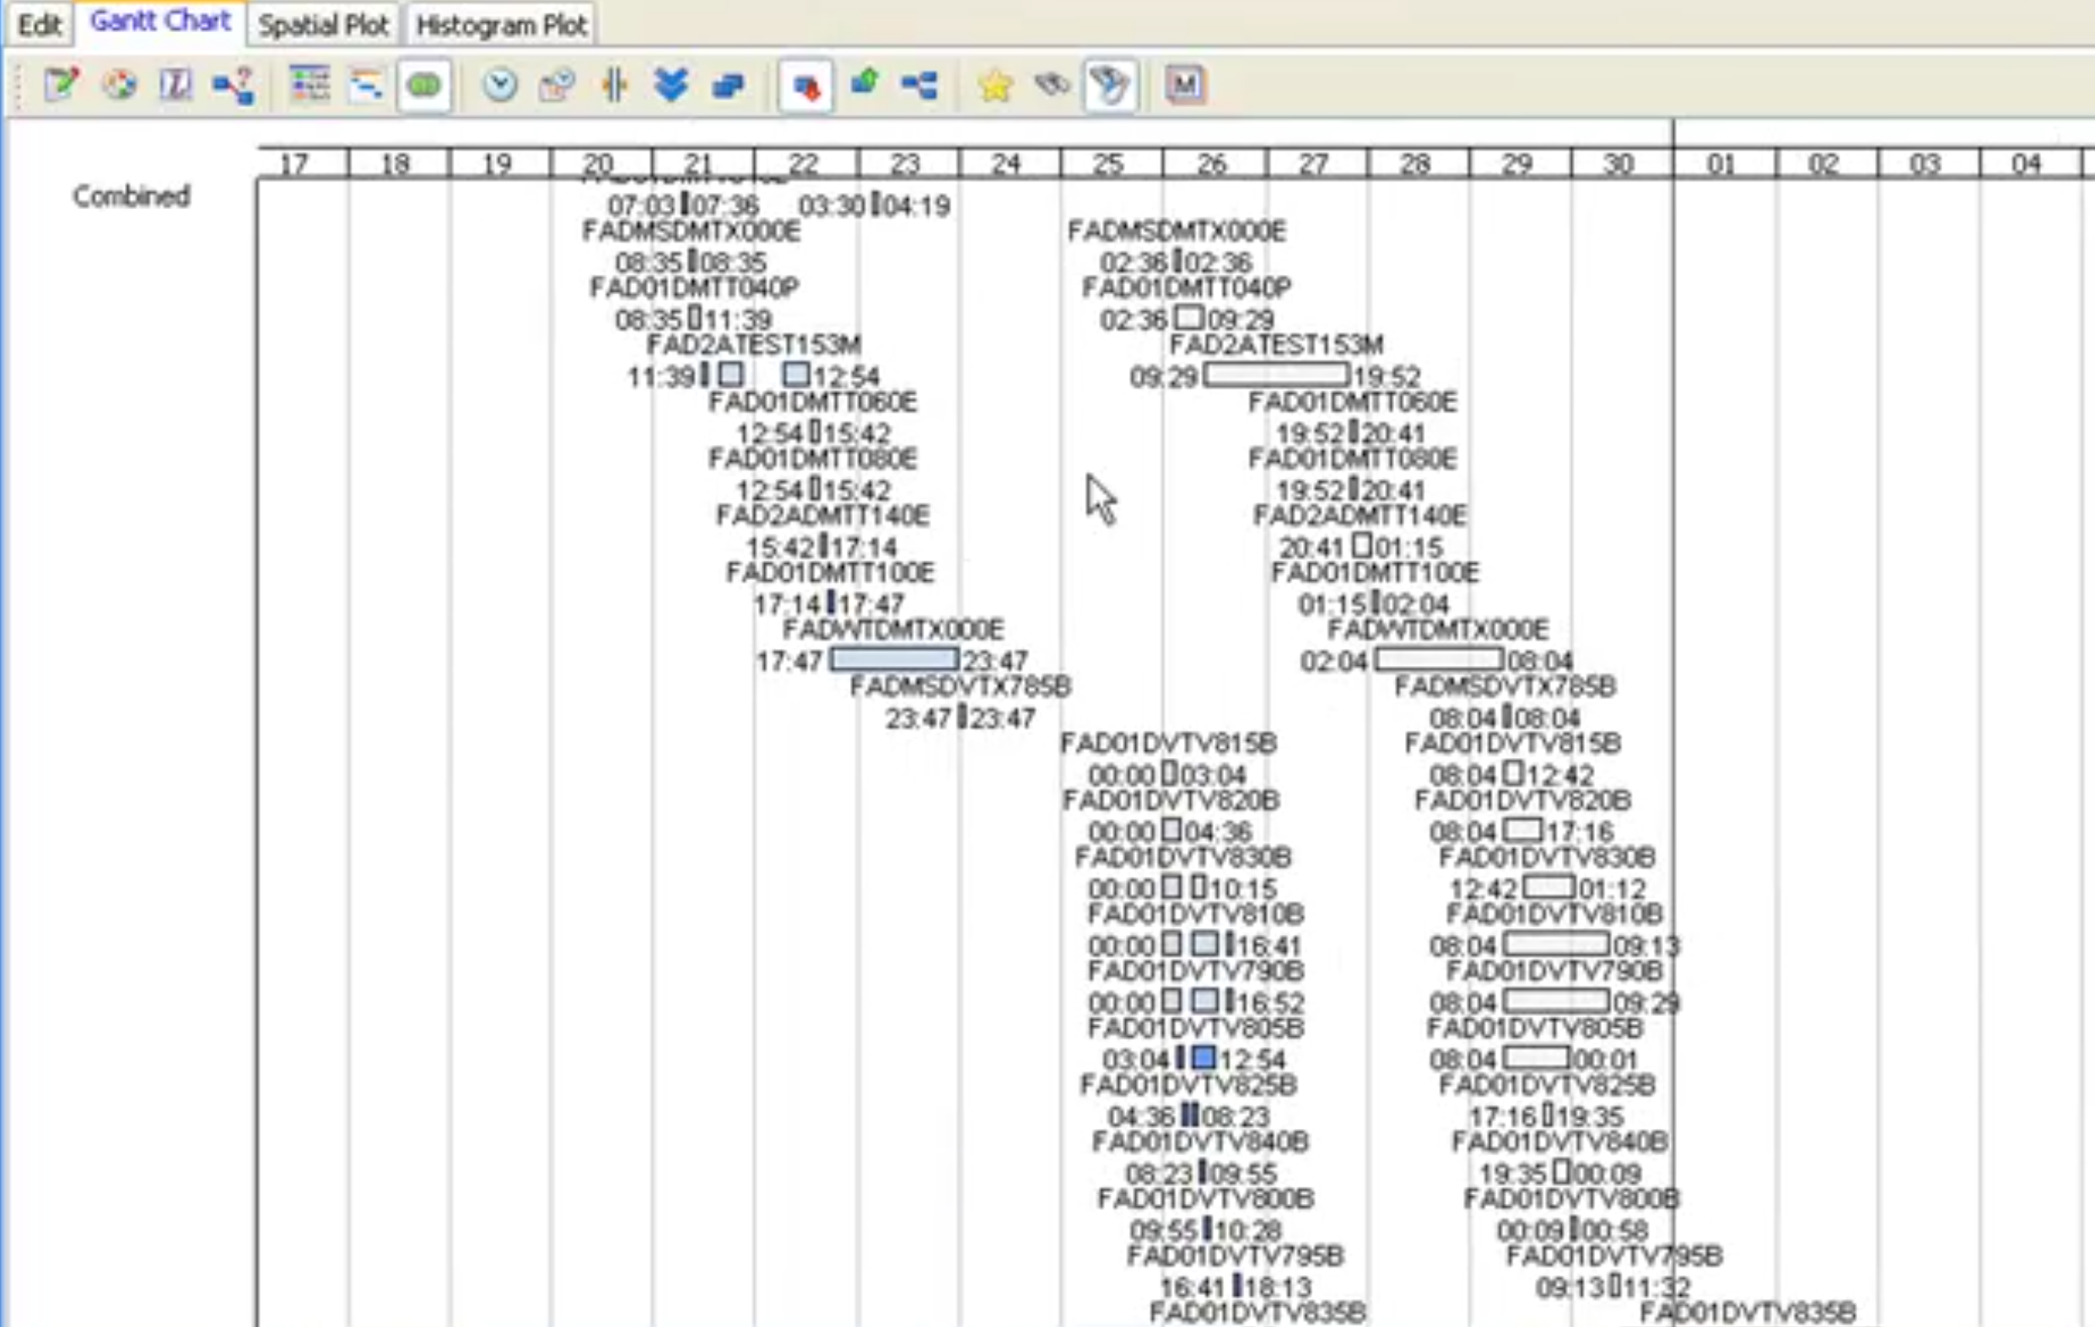
What-if: WORK WEEKEND to
GET BACK On Schedule

Slide 28
LESSONS
Efficient scheduling is incredibly difficult
  Significant productivity lost due to inferior scheduling
Learn from the human schedulers
Model to level of detail required
Reveal & explain the schedule
Easy & fast to perform scenarios / what-ifs

Slide 29
Aurora
Available to all of NASA
BOEING ALSO has site license

